Slide 1
Logistic Regression
Notes:
Heads up – will be some maths

Slide 2
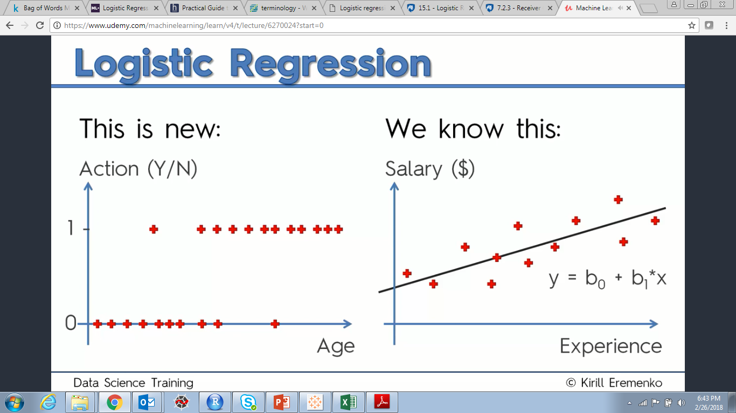
Logistic Regression - Intuition
Notes:
In Logistic Regression, output is non-normally distributed.

Slide 3
Logistic Regression - Intuition
Notes:
E.g. Your company sends out email offers to its customers. Intuitively, it appears that older people are more likely to take action than younger people. How do we model this behavior? How about a linear regression? Lets start thinking in terms of probabilities.

Slide 4
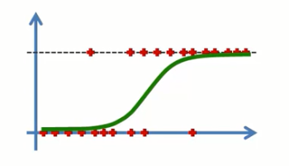
Logistic Regression - Intuition
y = b0 + b1*x
Sigmoid Transformation
ln(p/(1-p)) = b0 + b1*x,
Where
P = 1/(1+e^{-y}) is the logit/sigmoid function. p/(1-p) is called the odds ratio
Notes:
How to find the best fitting curve? Odds ratio = p(Success)/p(Failure)

Slide 5
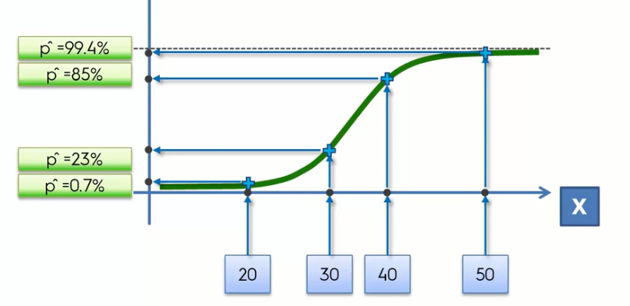
Logistic Regression - Intuition

Slide 6
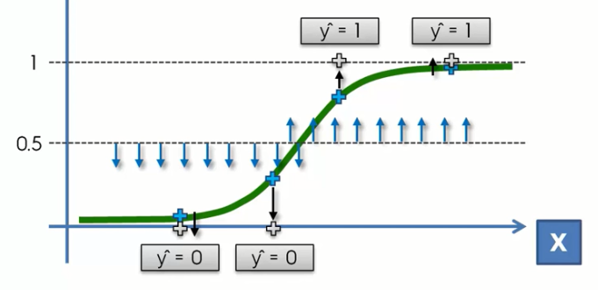
Logistic Regression - Intuition

Slide 7
Logistic Regression - Intuition
P(y = 1|x) = y^{-hat}
P(y = 0|x) = (1-y^{-hat})
This can be written compactly as P(y|x) = y^{-hat}^y * (1-y^{-hat})^(1-y)
This is called likelihood.
If we take the log of likelihood, we get
Log(y^{-hat}, y) = y*log(y^{-hat}) + (1-y)*log(1-y^{-hat})
This is the cost function for logistic regression. The objective is to maximize this log likelihood for all the inputs variables

Slide 8
More on Logistic Regression
Belongs to the family of Generalized Linear Models
Notes:
Discuss use cases

Slide 9
More on Logistic Regression
What are Generalized Linear Models?
GLMs are an extension of the linear model framework, which includes dependent variables which are non-normal. In general, they possess three characteristics:
These models comprise a linear combination of input features.
The mean of the response variable is related to the linear combination of input features via a link function.
The response variable is considered to have an underlying probability distribution belonging to the family of exponential distributions such as binomial distribution, Poisson distribution, or Gaussian distribution.
Notes:
Binomial distribution is used when the response variable is binary. Poisson distribution is used when the response variable represents count. And, Gaussian distribution is used when the response variable is continuous.

Slide 10
More on Logistic Regression
Following are the assumptions made by Logistic Regression:
The response variable must follow a binomial distribution.
Logistic Regression assumes a linear relationship between the independent variables and the link function (logit).
The dependent variable should have mutually exclusive and exhaustive categories
There should be little or no multicollinearity among the independent variables.

Slide 11
Lets consider an example…
Social_Network_Ads.csv

Slide 12
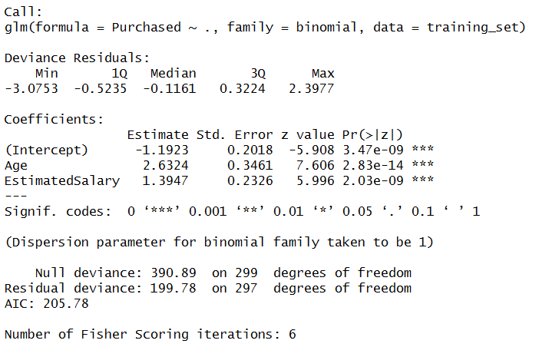
Lets understand the output….
Notes:
What is the model equation?

Slide 13
Lets understand the output….
Notes:
Indicates that both Age and Estimated Salary are positively related to the Purchased variable, i.e. higher the age and salary, higher is the probability of purchase.

Slide 14
Lets understand the output….
Notes:
Can be used to calculate the confidence intervals of the estimates

Slide 15
Lets understand the output….
Notes:
Obtained by dividing estimates by the std. errors

Slide 16
Lets understand the output….
Notes:
Obtained from the z values. Lower values will mean more stars, which in turn would mean more significance attached to that predictor/independent variable

Slide 17
Lets understand the output….
Notes:
Deviance is a measure of goodness of fit (badness of fit–higher numbers indicate worse fit). Null deviance shows how well the response variable is predicted by a model that includes only the intercept (grand mean). Equivalent to R² in Regression

Slide 18
Lets understand the output….
AIC = -2LL+2k
LL = Log Likelihood of the model
(max of the cost function),
k = Number of parameters
Notes:
Provides a method for assessing the quality of your model by comparison of related models. Based on the Deviance, but penalizes you for making the model more complicated. Equivalent to Adj R2. However, the number itself is not meaningful. Select a model with the least AIC. It’s useful for comparing models, but isn’t interpretable on its own.

Slide 19
Lets understand the output….
Notes:
Algorithm for solving maximum likelihood problems numerically. Our model needed six iterations to perform the fit. This indicates that model did indeed converge, and had no trouble doing it.

Slide 20
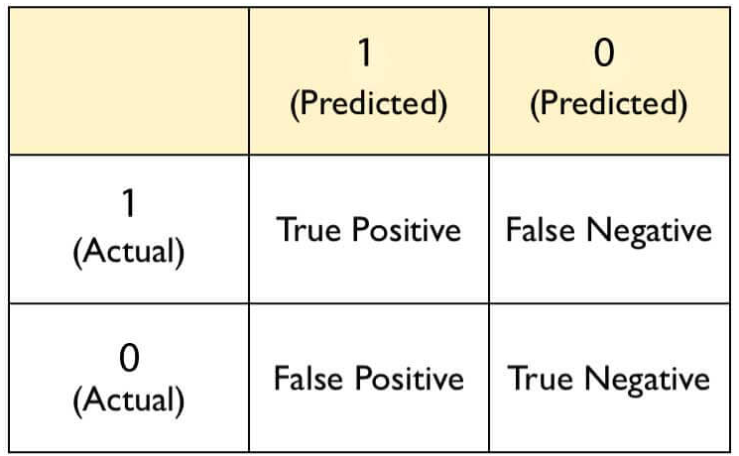
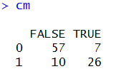
Lets understand Confusion Matrix in details…
Notes:
FP = Type I error. FN = Type II error

Slide 21
Lets understand Confusion Matrix in details…
 | 1 (+ve) | 0 (-ve)
1 | TP | FN
0 | FP | TN
Predicted
Actual
Notes:
Accuracy = (TP + TN)/ All

Slide 22
Lets understand Confusion Matrix in details…
 | 1 (+ve) | 0 (-ve)
1 | TP | FN
0 | FP | TN
Predicted
Actual
Notes:
TPR (Sensitivity/Recall) = TP/(TP + FN). How many positive values, out of all the positive values, have been correctly predicted

Slide 23
Lets understand Confusion Matrix in details…
 | 1 (+ve) | 0 (-ve)
1 | TP | FN
0 | FP | TN
Predicted
Actual
Notes:
FPR = FP/(FP + TN) = 1 – TPR. How many negative values, out of all the negative values, have been incorrectly predicted

Slide 24
Lets understand Confusion Matrix in details…
 | 1 (+ve) | 0 (-ve)
1 | TP | FN
0 | FP | TN
Predicted
Actual
Notes:
TNR (Specificity) = TN/(FP + TN) = 1 – FPR. How many negative values, out of all the negative values, have been correctly predicted

Slide 25
Lets understand Confusion Matrix in details…
 | 1 (+ve) | 0 (-ve)
1 | TP | FN
0 | FP | TN
Predicted
Actual
Notes:
FNR = FN/(TP + FN). How many positive values, out of all the positive values, have been incorrectly predicted

Slide 26
Lets understand Confusion Matrix in details…
 | 1 (+ve) | 0 (-ve)
1 | TP | FN
0 | FP | TN
Predicted
Actual
Notes:
Precision = (TP / TP + FP). Indicates how many values, out of all the predicted positive values, are actually positive.

Slide 27
Lets understand Confusion Matrix in details…
 | 1 (+ve) | 0 (-ve)
1 | TP | FN
0 | FP | TN
Predicted
Actual
Notes:
F Score = 2((precision*recall) / (precision+recall))
F score is the harmonic mean of precision and recall. It lies between 0 and 1. Higher the value, better the model.

Slide 28
Why not just use accuracy?
Lets consider a spam classifier, where we have 10 spams in the test data
Lets consider a cancer patients classifier, where we have 10 cancer patients in the test data
 | 1 (+ve) | 0 (-ve)
1 | 5 | 5
0 | 10 | 90
 | 1 (+ve) | 0 (-ve)
1 | 5 | 5
0 | 10 | 90
Non-spam
No Cancer
Spam
Cancer
Notes:
Accuracy in both the case is 95%. Which number should we be concerned about in both these cases?

Slide 29
Why not just use accuracy?
What is the precision & recall in these cases?
 | 1 (+ve) | 0 (-ve)
1 | 5 | 5
0 | 10 | 90
 | 1 (+ve) | 0 (-ve)
1 | 5 | 5
0 | 10 | 90
Non-spam
No Cancer
Spam
Cancer
Notes:
Precision (Spam case) = TP/(TP + FP) = 5/15 = 33%. Precision (Cancer case) = 33%
Recall (Spam case) = TP/(TP + FN) = 5/10 = 5%. Recall (Cancer case) = 5%. Obviously, we are concerned about Precision in case 1 and Recall in case 2.

Slide 30
Which terms to remember? And How??
If nothing else, just remember Precision & Recall!!
Precision = TP/(Predicted Positive)
Recall = TP/(Real Positive)
Notes:
https://www.quora.com/What-is-the-best-way-to-understand-the-terms-precision-and-recall

Slide 31
Dealing with Imbalanced Data
Choose appropriate threshold using ROC-AUC
Balance the data and stick to 0.5 threshold

Slide 32
ROC Curves
One of the problems with the confusion matrix is that all the values that are populated is based on an arbitrary choice of the threshold
Lets reconsider the Cancer patients example. Do you think a 50% threshold is justified in this case?
What if we could evaluate multiple thresholds and see their impact? This is how ROC curves are generated
ROC curves also help in deciding the threshold when you have unbalanced data with you

Slide 33
ROC Curves
Lets understand more about ROC curves
http://www.navan.name/roc/
https://youtu.be/OAl6eAyP-yo

Slide 34
Other ways of dealing with Unbalanced Data
Sampling Techniques:
Under sampling
Over sampling
Under & Over Sampling
Synthetic Data Generation
SMOTE (Synthetic Minority Over-sampling Technique)
ROSE (Random Over Sampling Examples)
Notes:
SMOTE is performed in R using DMwR package. Discuss advanteges & disadvantages

Slide 35
SMOTE & ROSE
ROSE uses smoothed bootstrapping to draw artificial samples from the feature space neighborhood around the minority class
SMOTE draws artificial samples by choosing points that lie on the line connecting the rare observation to one of its nearest neighbors in the feature space
https://www.openstarts.units.it/bitstream/10077/4002/1/Menardi%20Torelli%20DEAMS%20WPS2.pdf

Slide 36
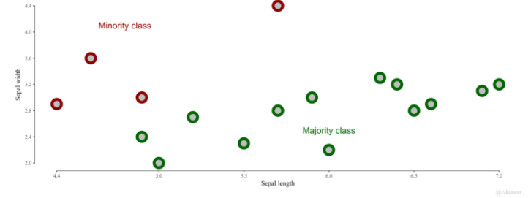
SMOTE
Notes:
Based on the green domination, a machine learning algorithm could simply classify everything as green and still be correct 76% of the time

Slide 37
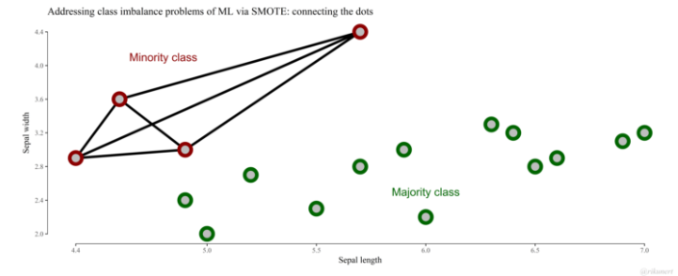
SMOTE

Slide 38
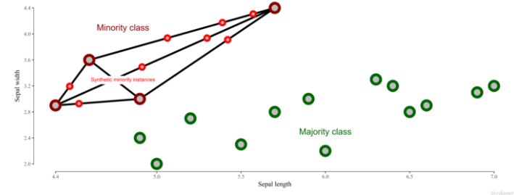
SMOTE

